Slide 1
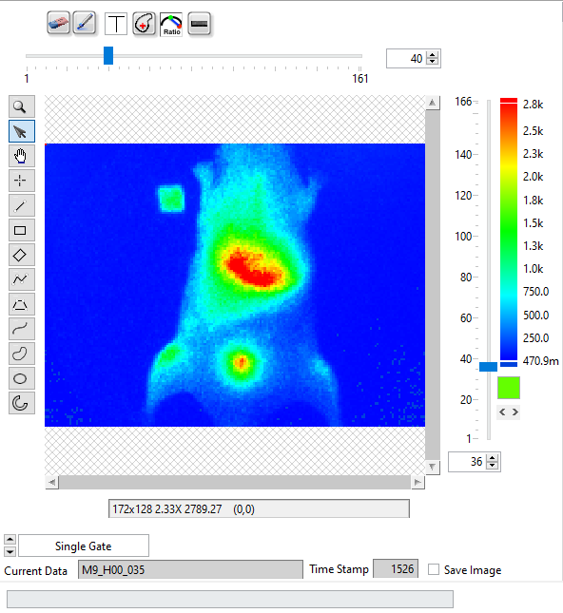
1 2 3 4 5 6
Gate Image Slide
Tool Palette
ROI
Color
ROI
Selector
Time Series Slide
Image Selector

Slide 2
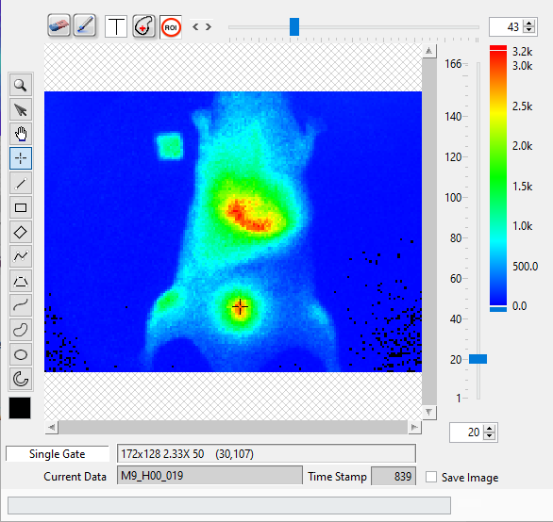
1 2 3 4 5 6
Gate Image Slide
Tool Palette
Time Point Slide
ROI
Color
Image Selector

Slide 3
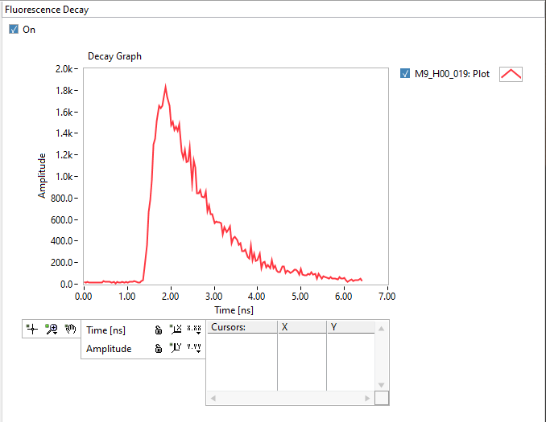
Plot
Legend
Plot Area
Y Scale
X Scale
Cursor
Legend
Graph
Palette
Scale
Legend

Slide 4
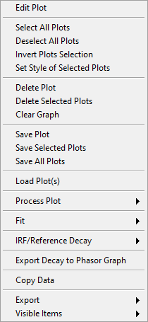

Slide 5
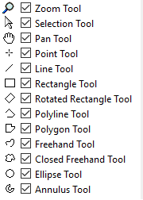

Slide 6
L
W

